Slide 1
ELEMENTARY STATISTICS, BLUMAN
TI Calculator – Binomial Distribution
© 2019 McGraw-Hill Education. All rights reserved. Authorized only for instructor use in the classroom. No reproduction or further distribution permitted without the prior written consent of McGraw-Hill Education.

Slide 2
Objectives for this PowerPoint
How to calculate binomial probabilities using the TI Graphing Calculator

Slide 3
Problem
According to the 2012 Pet Ownership and Demographics Sourcebook, 36.5% of US households own at least 1 dog. If 10 US households are randomly selected, what is the probability that at least 4 would own at least 1 dog?

Slide 4
Check Criteria
There are n = 10 trials.
There are only 2 possible outcomes; either a household owns a dog or does not.
Whether a randomly selected household owns a dog has no effect on the probability that another household owns a pet.
The probability of a success remains a constant 0.365 from trial to trial.

Slide 5
Example
According to the 2012 Pet Ownership and Demographics Sourcebook, 36.5% of US households own at least 1 dog. If 10 US households are randomly selected, what is the probability that at least 4 would own at least 1 dog?
In order to use the TI graphing calculator to find a probability that x is greater than or equal to some value we must subtract an accumulated binomial probability from 1.
P(x ≥ 4) = 1 – P(x ≤ 3)

Slide 6
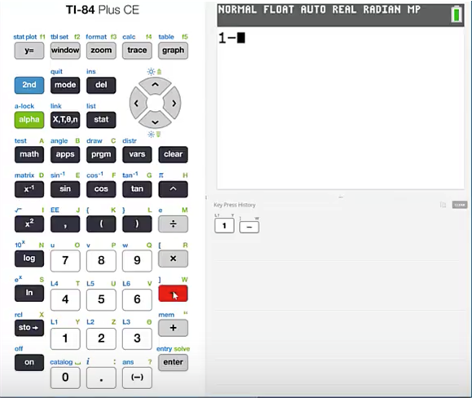
TI Calculator (1)
Type 1 minus and press

Slide 7
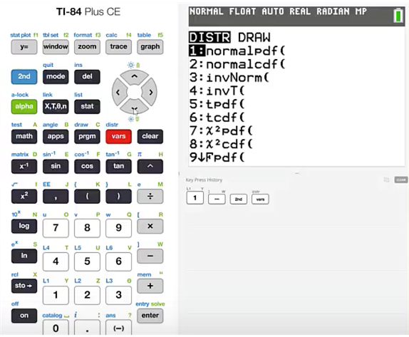
TI Calculator (2)
Press 2nd vars

Slide 8
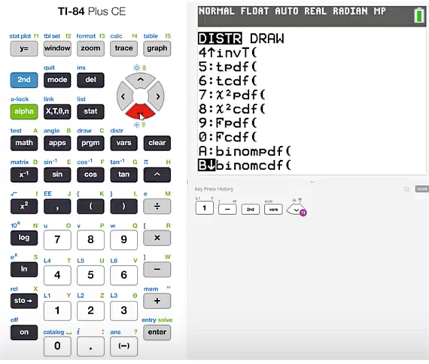
TI Calculator (3)
Cursor down until you find the binomcdf function
Press enter

Slide 9
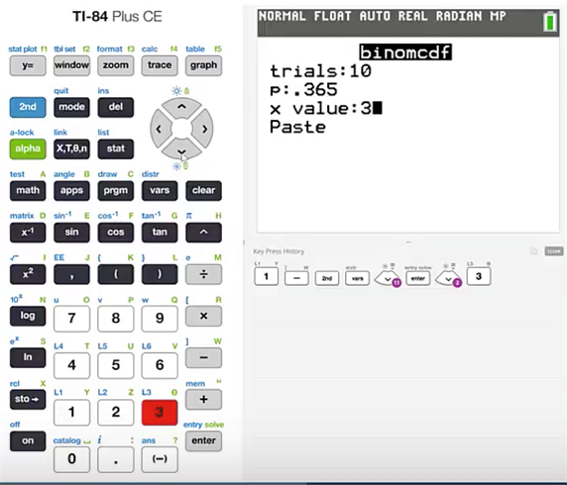
TI Calculator (4)
The number of trials is 10.
The probability of a success is 365.
This time we’re going to find the probability that x is greater than or equal to 4. We will have to subtract the probability that x is less than or equal to 3 from 1.
Cursor down and highlight paste and press enter.

Slide 10
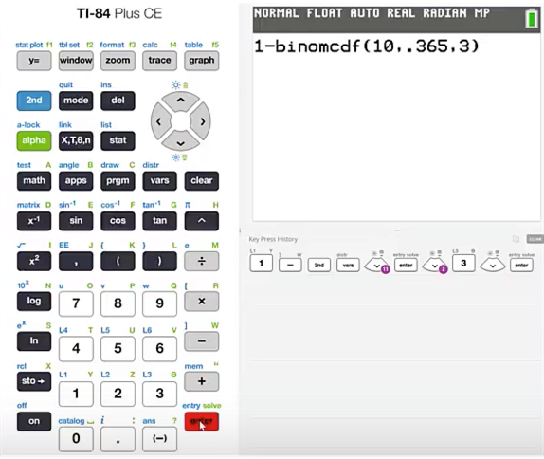
TI Calculator (5)
If you are using a TI graphing calculator that does not present a menu for entering the required values then you will need to place the values in order. That order will be n, p, x.
Press enter

Slide 11
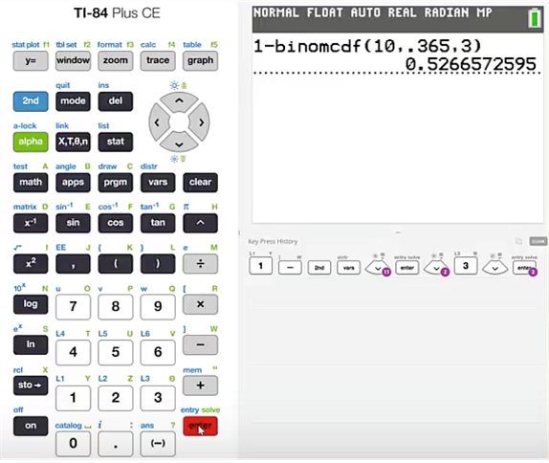
TI Calculator (6)
We will find that this probability is 0.5267 if we round to 4 decimal places.

Slide 12
Summary
In this PowerPoint, we learned how to calculate binomial probabilities using the TI graphing calculator.

